Slide 1
A group project for visualization of supercharger stations in California
to navigate best locations to implement supercharger stations
based on current saturations and EV populations.
Supercharger Location Analysis
By
Charissa Hoxie Toshi Torihara Michael Farm

Slide 2
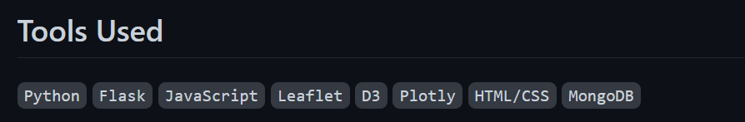
Data Source
The National Renewable Energy Laboratory https://developer.nrel.gov/docs/transportation/alt-fuel-stations-v1/all/
Alternative Fuels Data Center
https://afdc.energy.gov/data/search?q=electricity
Carvana
https://www.carvana.com/cars/tesla

Slide 3
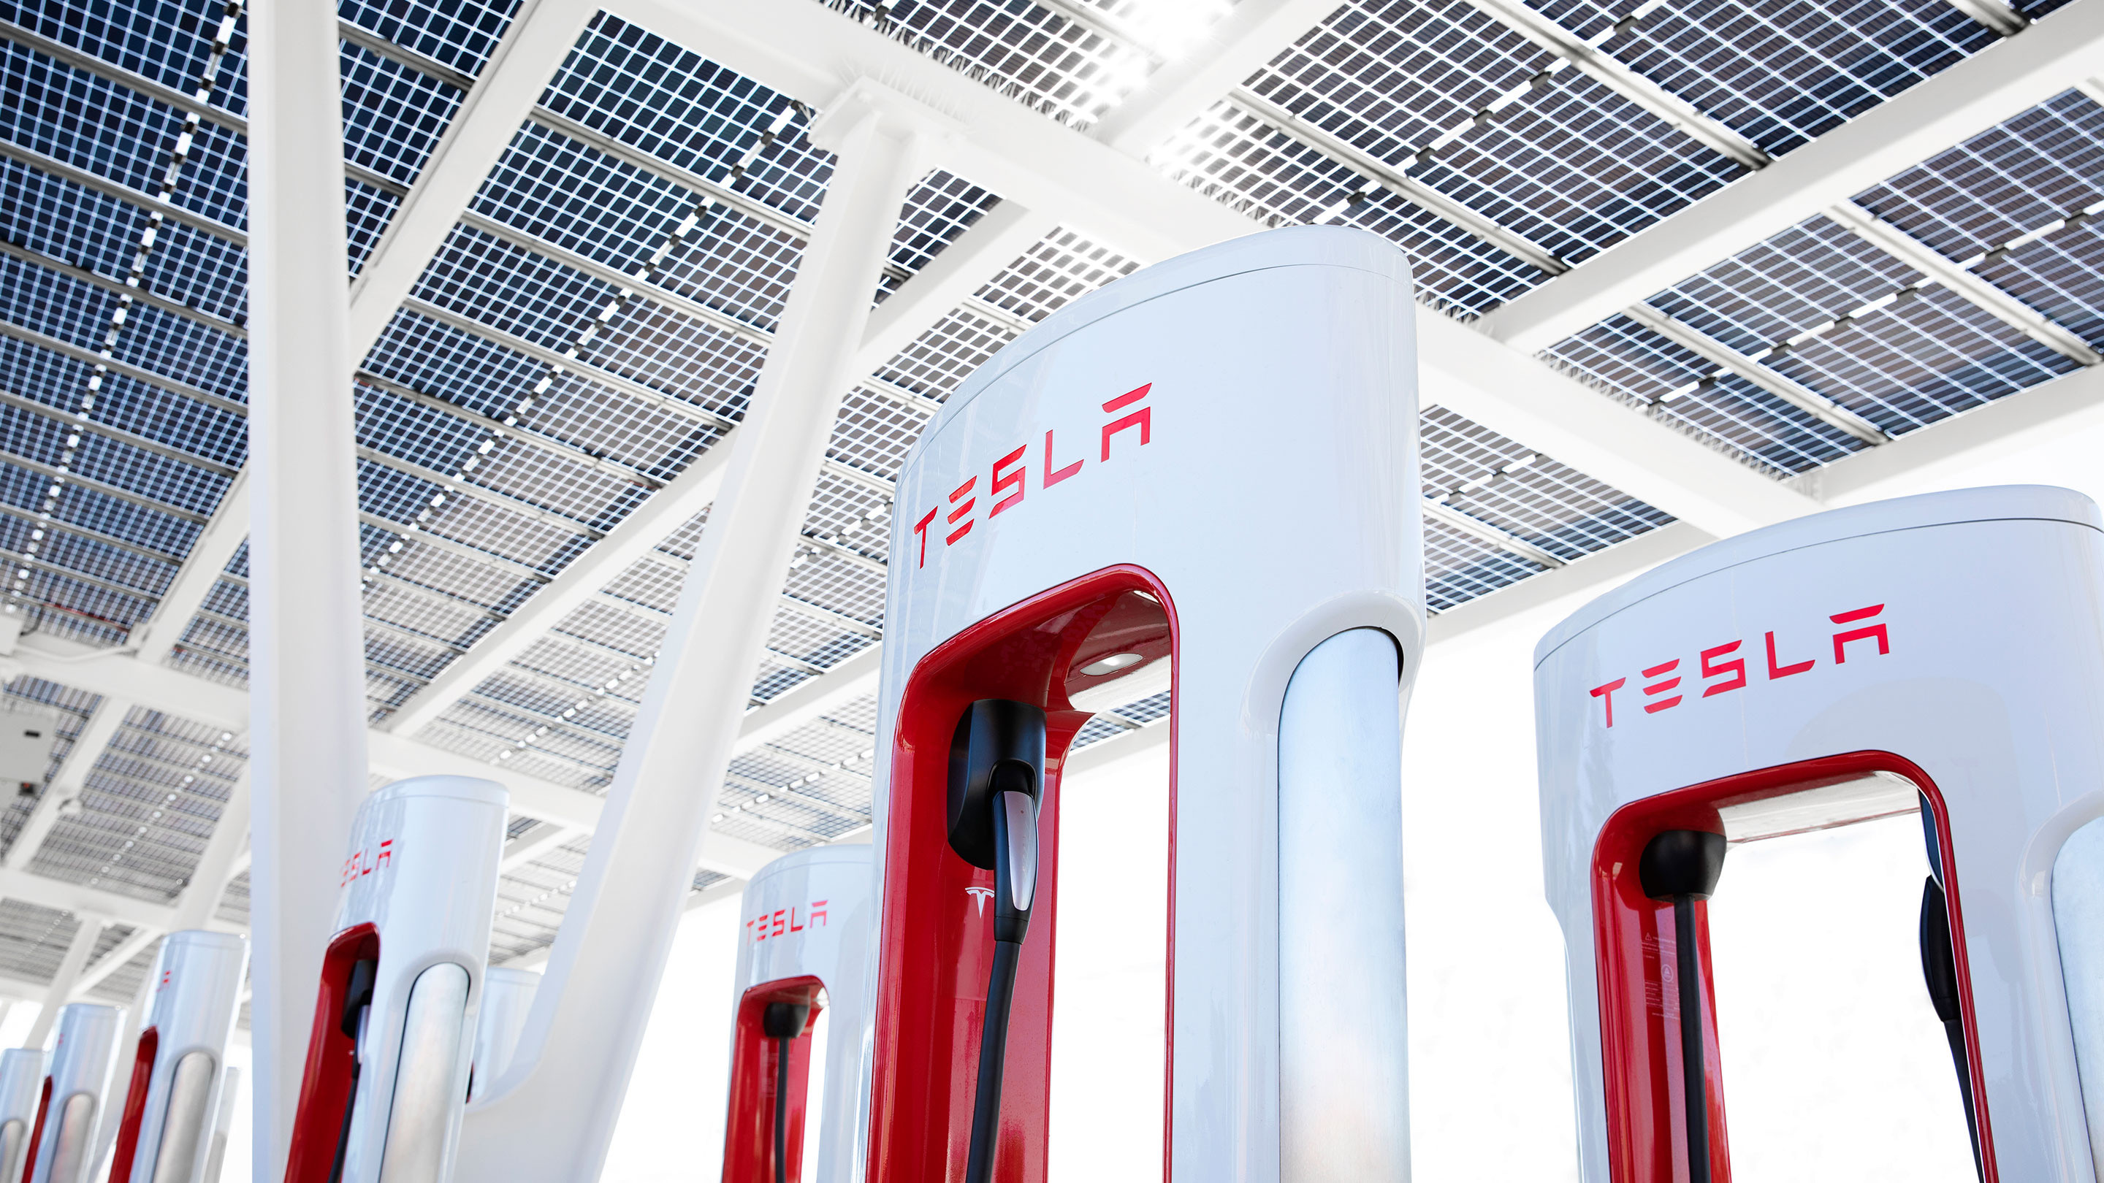
Leaflet (Javascript) Interactive Map/Chart

Slide 4
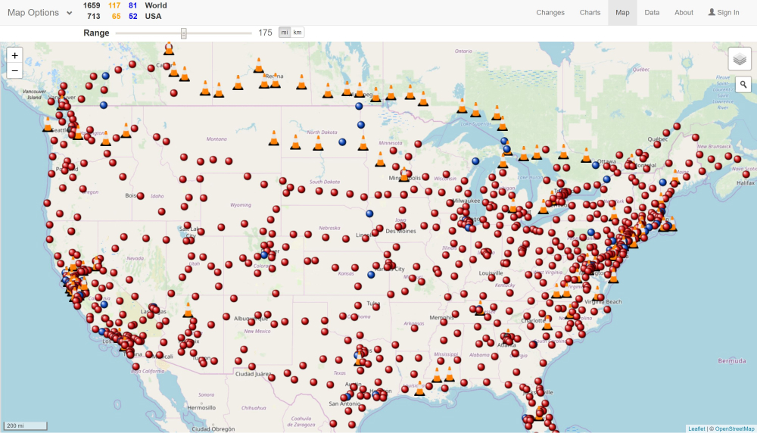

Create interactive map of charging locations in California from EV Charger Mapping

Slide 5
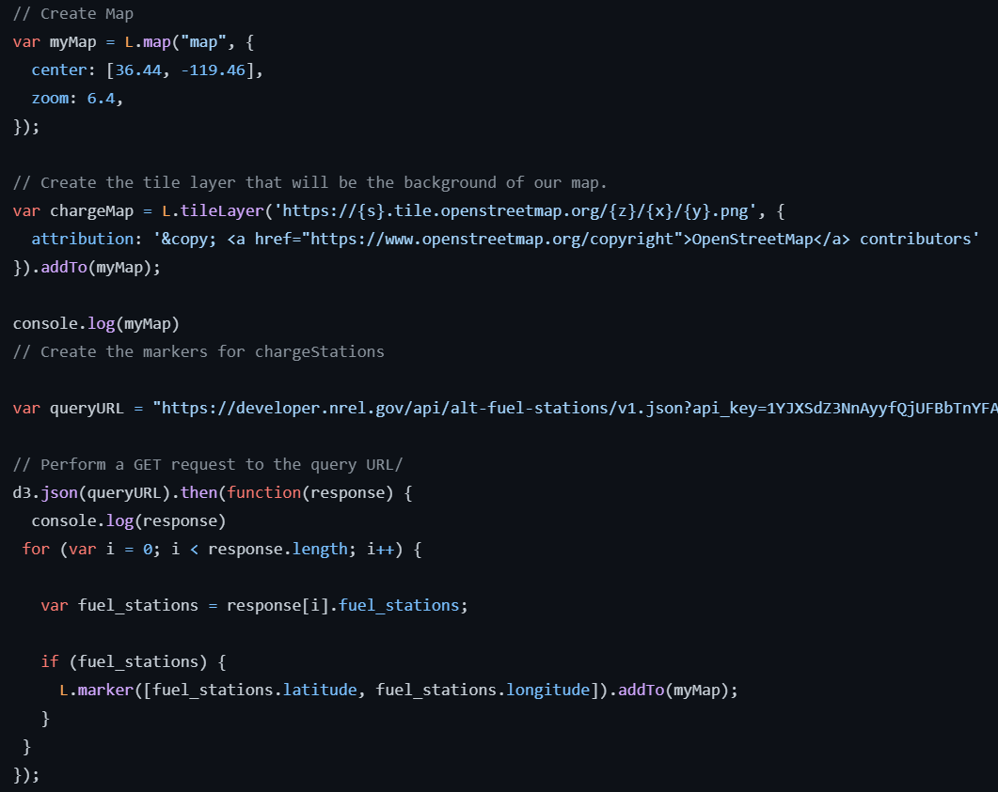

Slide 6
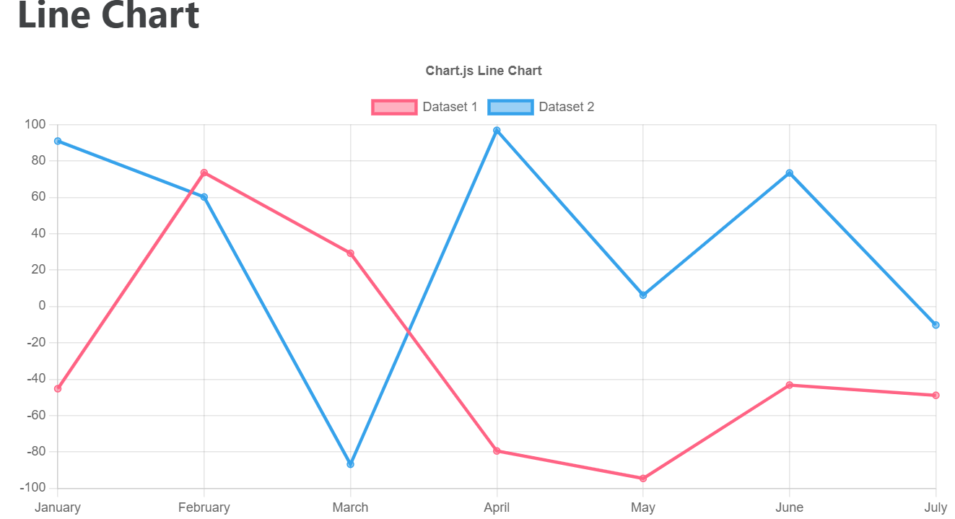

Create an interactive JavaScript table by extracting EV populations from 2010 to 2020 from the CSV dataset. A line chart to show the EV population from the registration data.

Slide 7
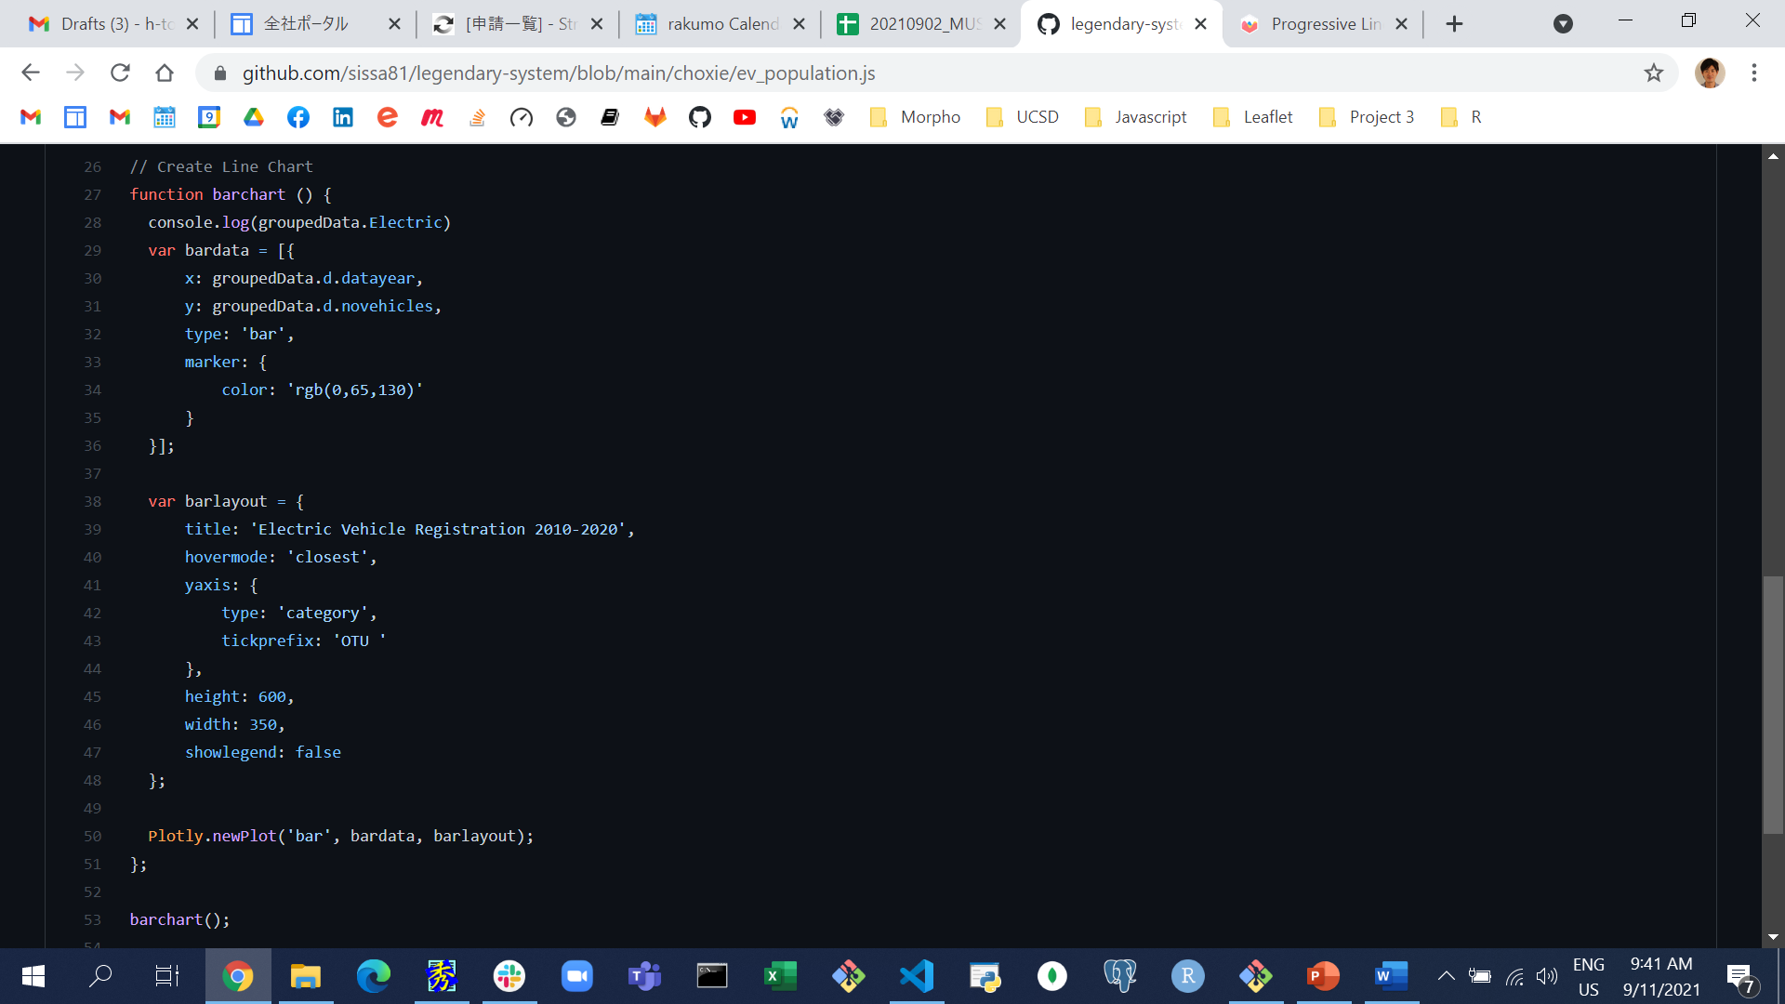
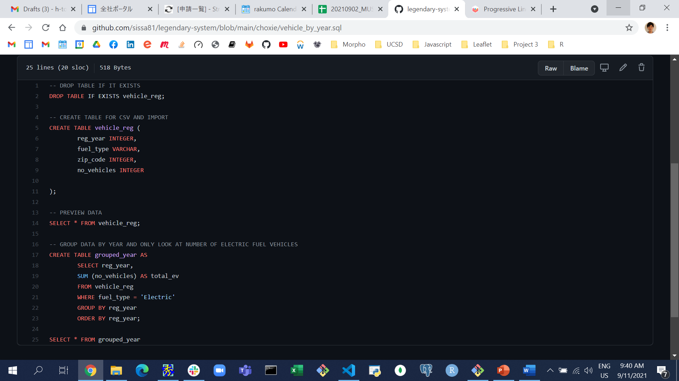

Slide 8
Flask app and Web-scraping

Slide 9
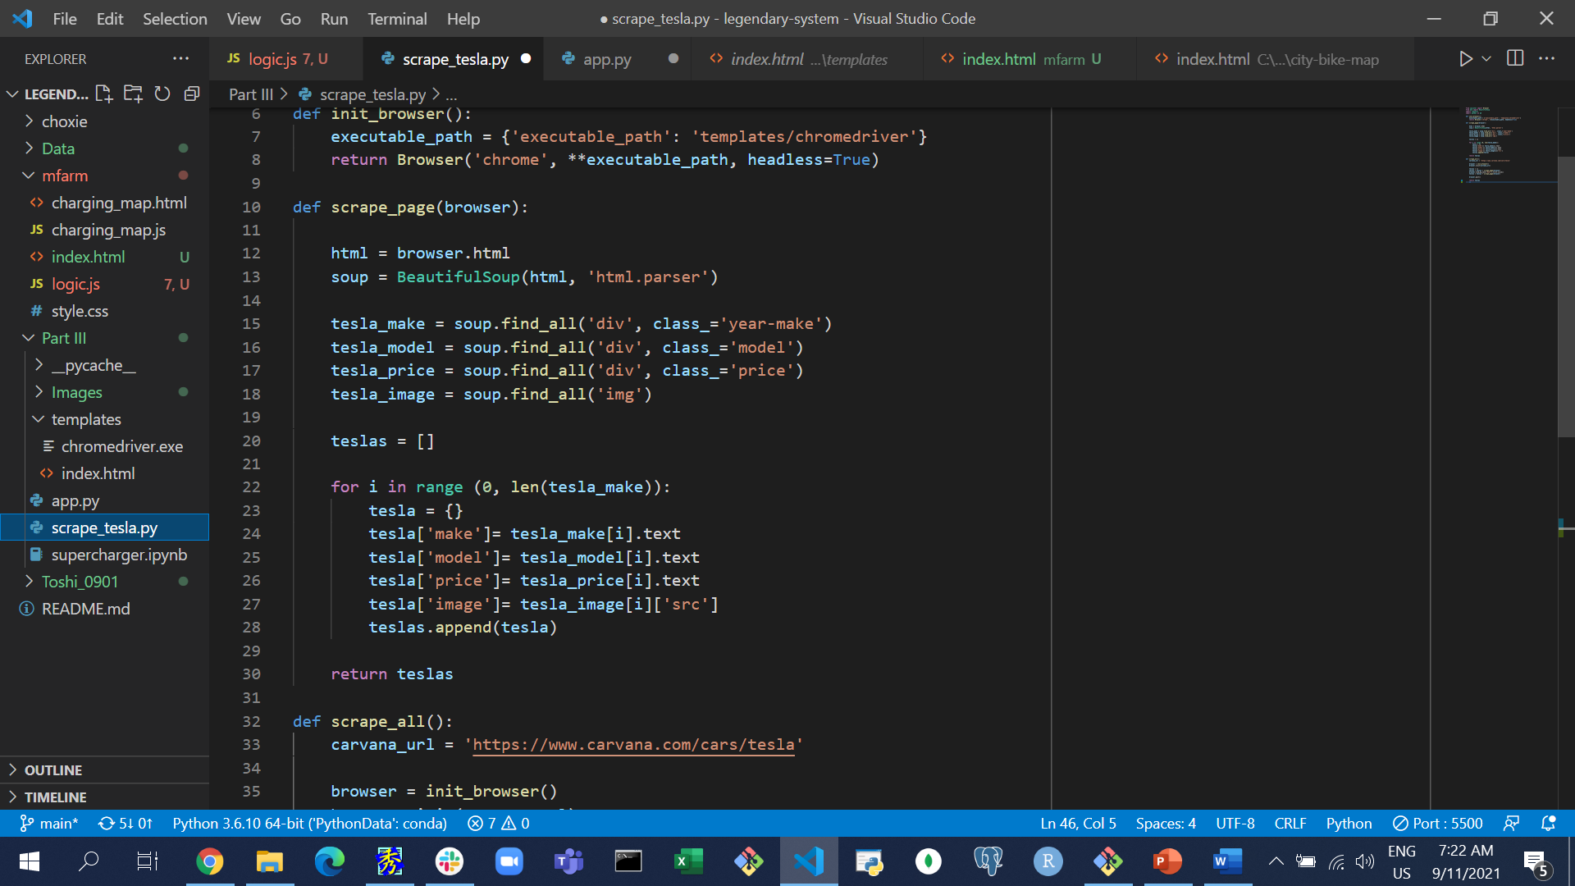
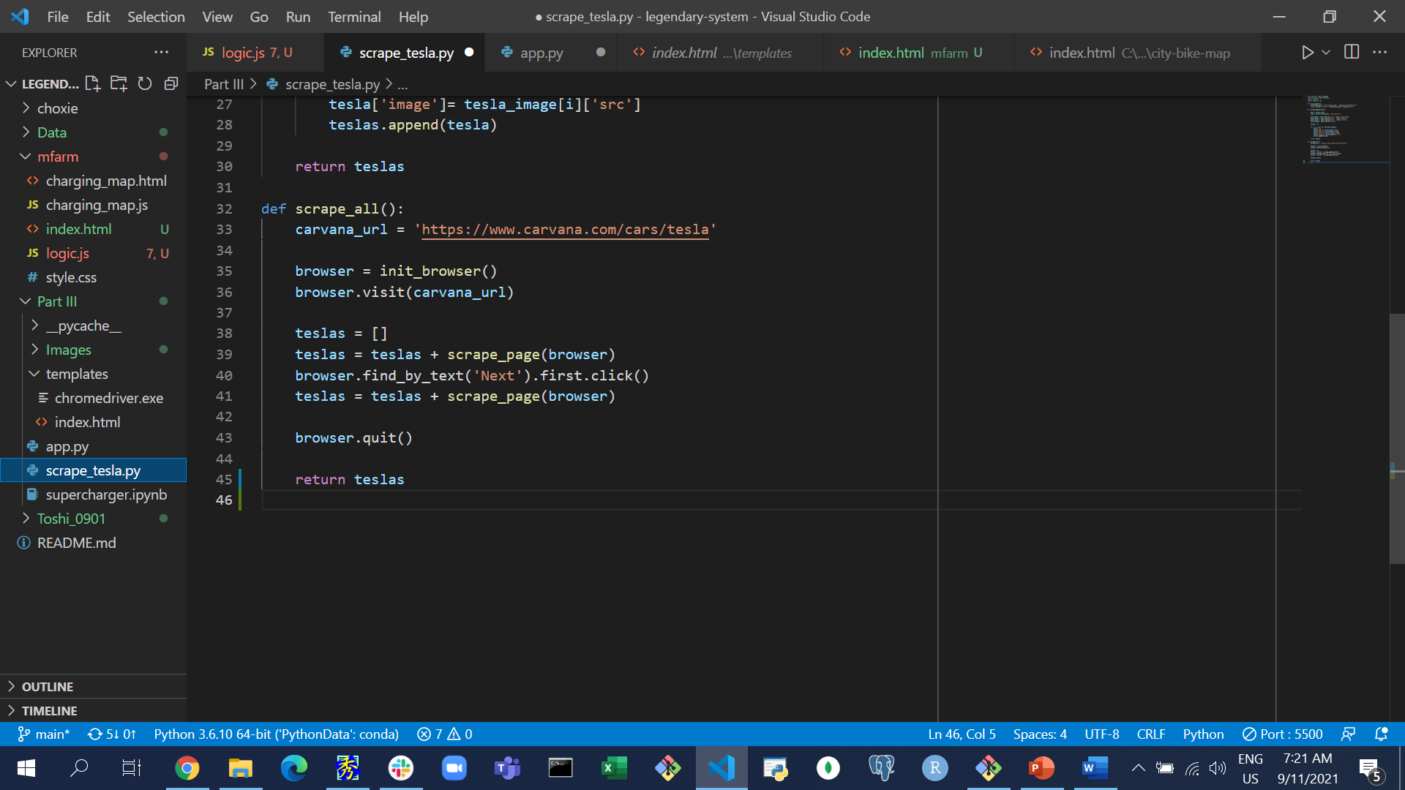
scrape_tesla.py
Using Splinter, get information of Tesla models by web-scraping off of Carvana site. Created functions as below.
scrape_page(browser):
Using BeautifulSoup and ‘find_all’ function and for loop to extract the make, model, price, and images of each Tesla
scrape_all():
Further look into next page by ‘find_by_text’ and repeat scrape_page

Slide 10
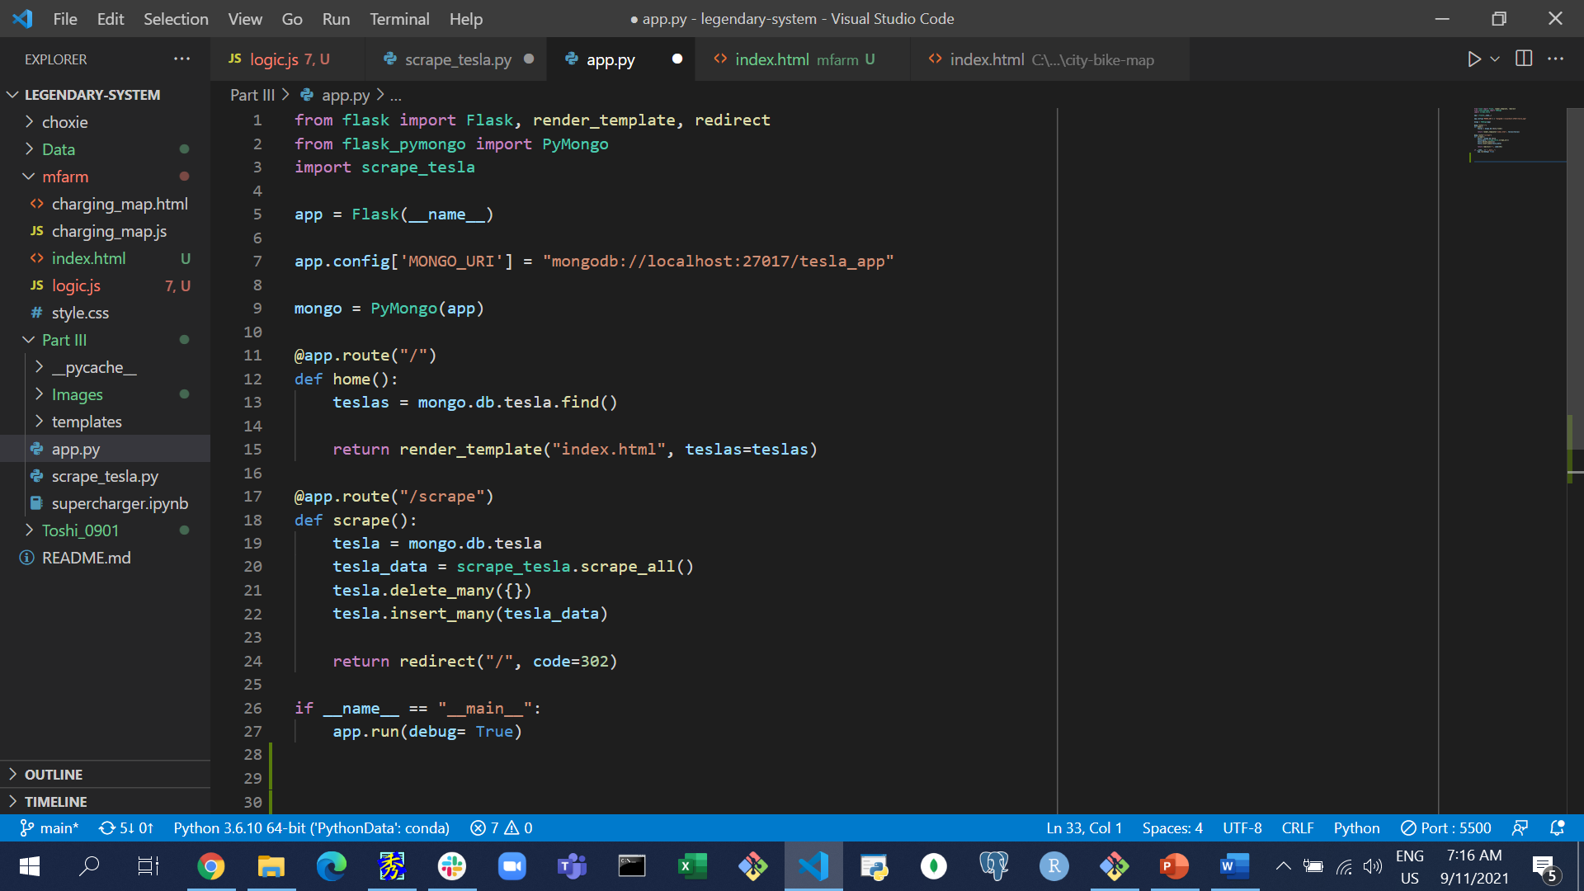
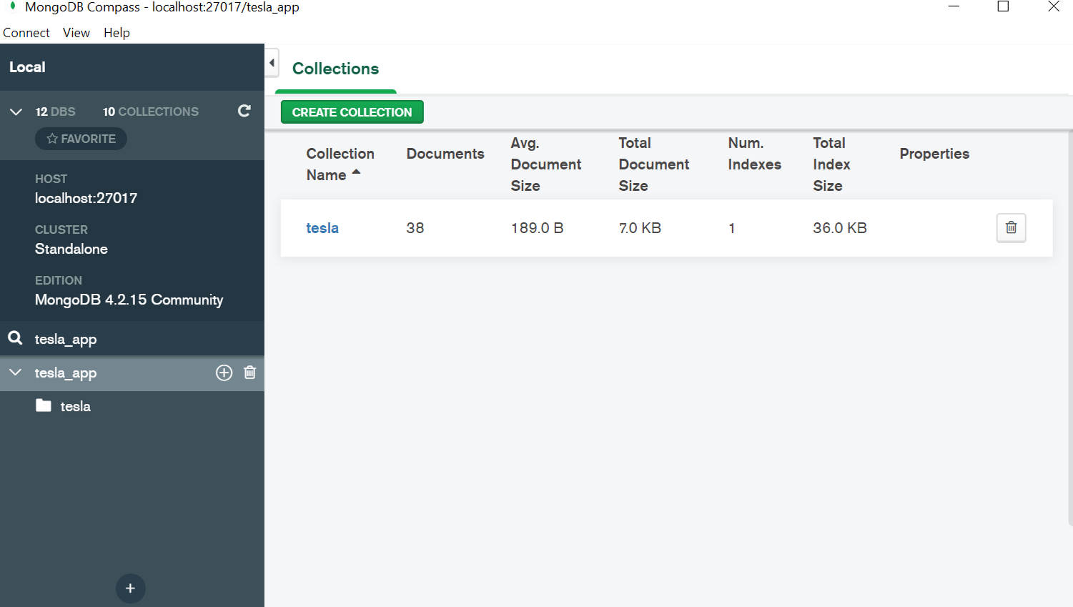
app.py
Using FlaskApp/PyMongo to store extracted Tesla data and connect to a MongoDB database named tesla_app

Slide 11
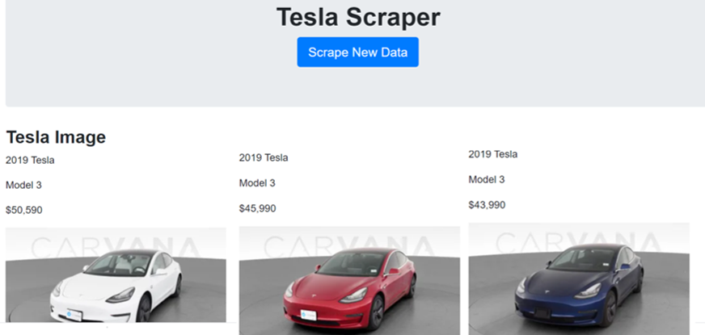
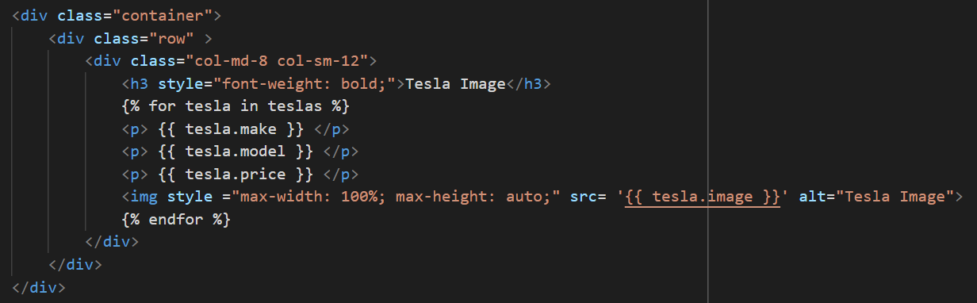
index.html
Create HTML with connection to python apps to generate Tesla Scraper to display all the data

